Slide 1
Deforestation Detection Using CNN with Audio Classification
Methodology Overview

Slide 2

Data Collection
- Collect audio samples from various environments: forest background, storms, engines, and chainsaws
- Label data for supervised learning.
Types of Audio Data
Background Sounds: Natural sounds of the Forest.
Engine Sounds: Engine sounds from the JCB`s and heavy vehicles.
Chain saw sounds :Sounds from the chainsaw machine.
Storms sounds: Sounds of rains and stroms and thunders.
Collected 100 samples of every class

Slide 3
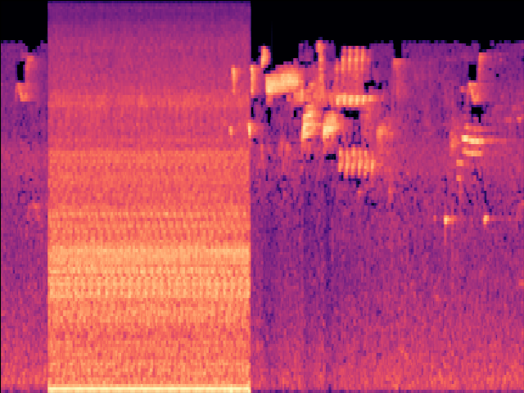
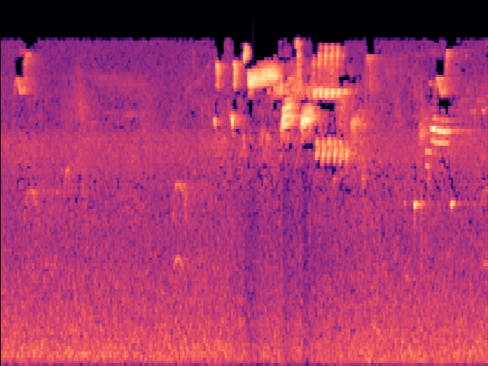
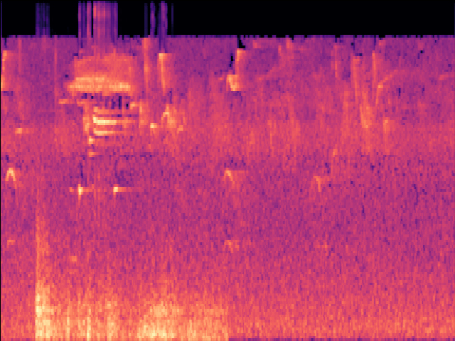
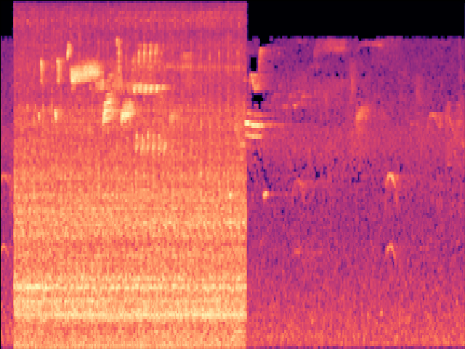
Data Processing: Spectrogram Conversion
- Convert audio signals into spectrogram images for CNN processing.
- Use Mel spectrograms for feature extraction.
- Normalize and augment data for robustness.
Examples: bagrounds
Engine sound
Background sound
Chainsaw sound
Strom sound

Slide 4
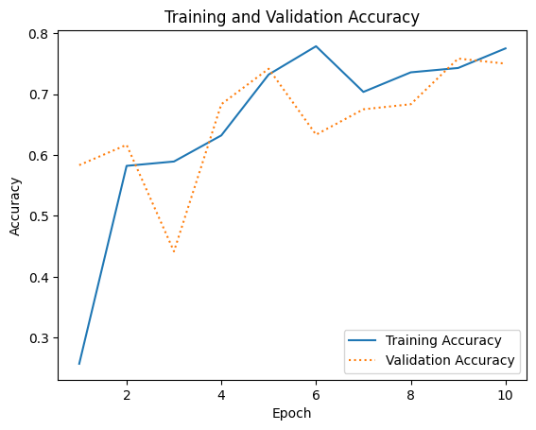
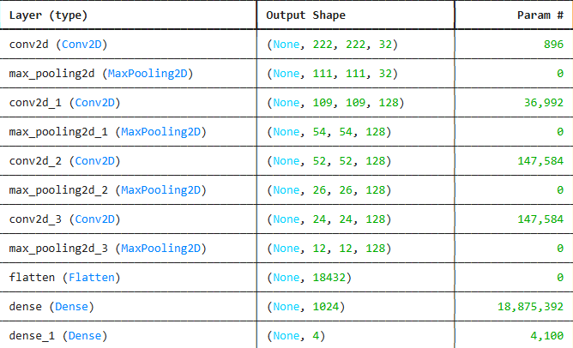
Training and Testing the Model:
- Train a Convolutional Neural Network (CNN) on spectrogram images.
- Split dataset into training 75%, validation25%, and testing sets.
- Uses 10 epochs obtained accuracy 79%

Slide 5


Deployment Options (ongoing)
- Convert trained Keras/TensorFlow model to C++ libraries for ESP32 deployment.
- Deploy model on Raspberry Pi using Python and TensorFlow Lite.
- Optimize model size and performance for edge devices.
Cost: low
Speed: slow
Accuracy: Low
Power consumption: Low
Complexity: High
Cost: High
Speed : High
Accuracy: High
Power consumption: High
Complexity : Easy

Slide 6
Pipeline Flowchart: Microphone to Classification
Capture
- Capture real-time audio input from a microphone.
Convert
- Convert audio to spectrogram in real-time.
Pass
- Pass the spectrogram to the trained CNN model.
Classify
- Classify the sound as background, storm, engine, or chainsaw.
Output
- Output classification result for further action.

